Slide 1
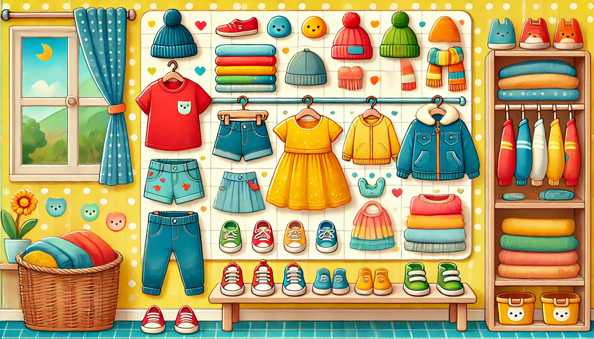
Vêtements
Livre de Coloriage

Slide 2


Tracer & Colorer
Ma garde-robe
Robe

Slide 3


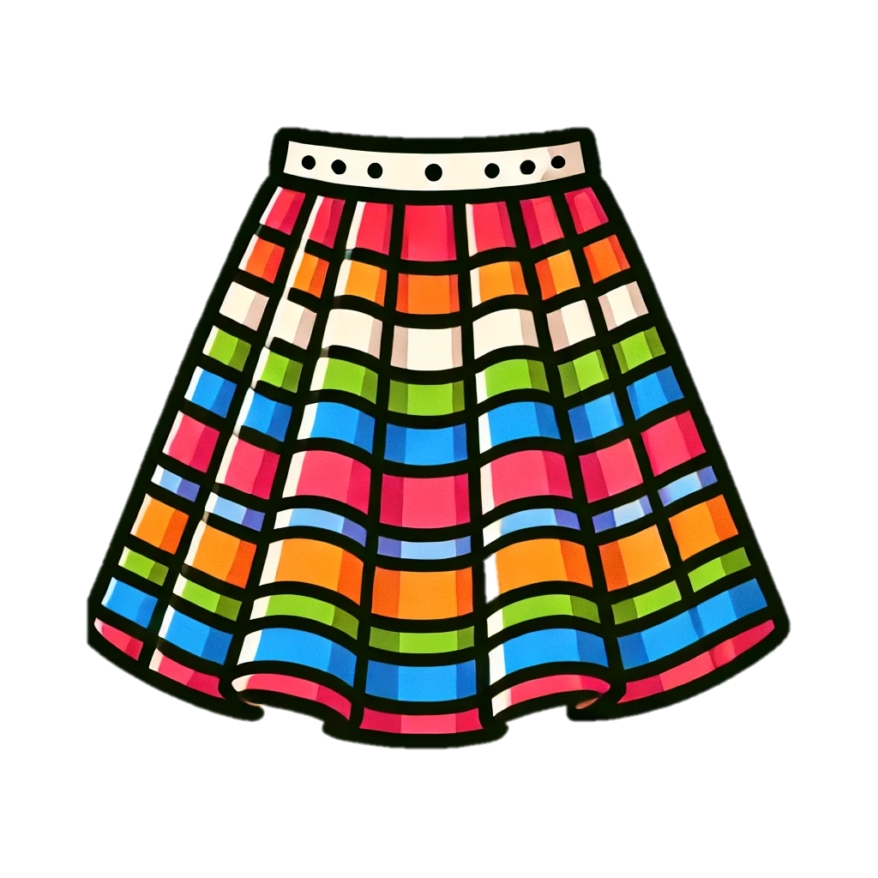

Tracer & Colorer
Jupe
Ma garde-robe

Slide 4
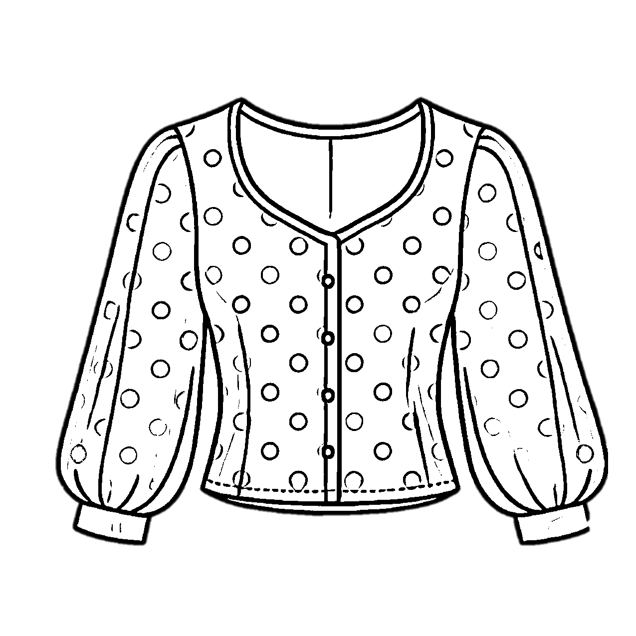
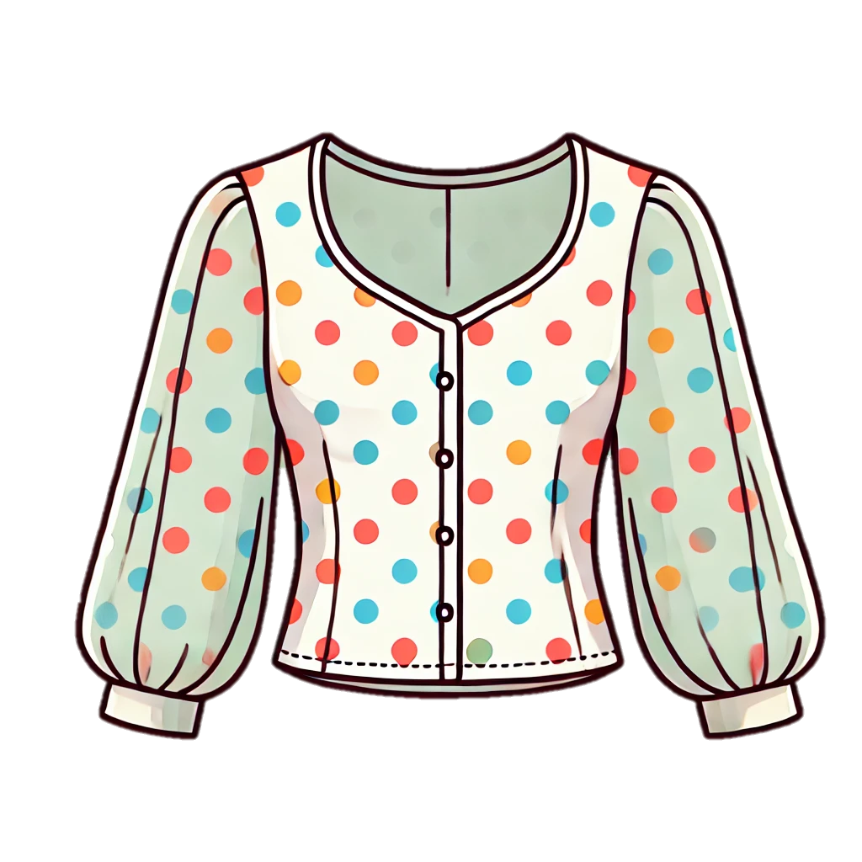
Tracer & Colorer
Ma garde-robe
Blouse

Slide 5


Tracer & Colorer
Ma garde-robe
T-shirt

Slide 6


Tracer & Colorer
Ma garde-robe
Chemise

Slide 7
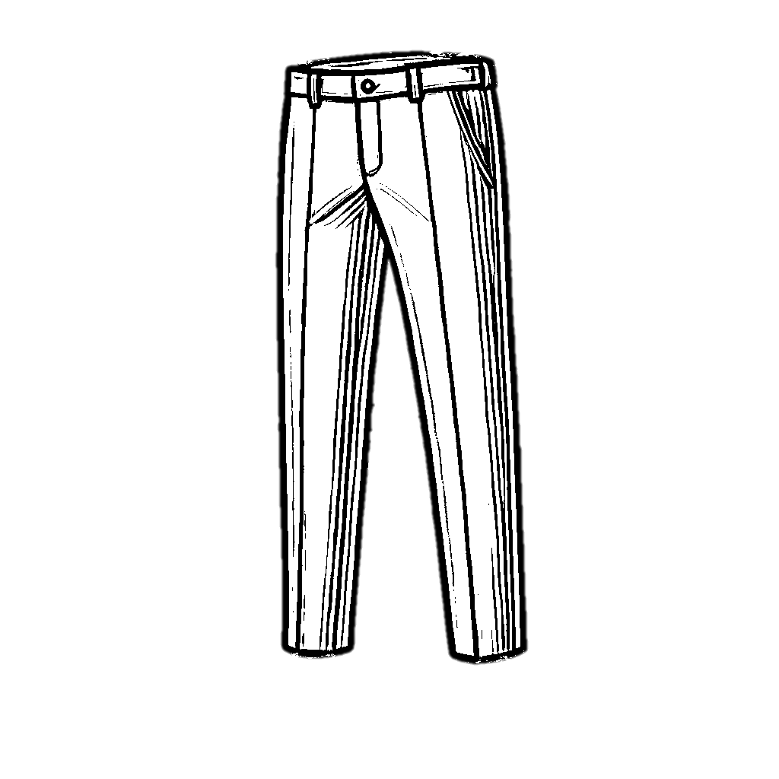
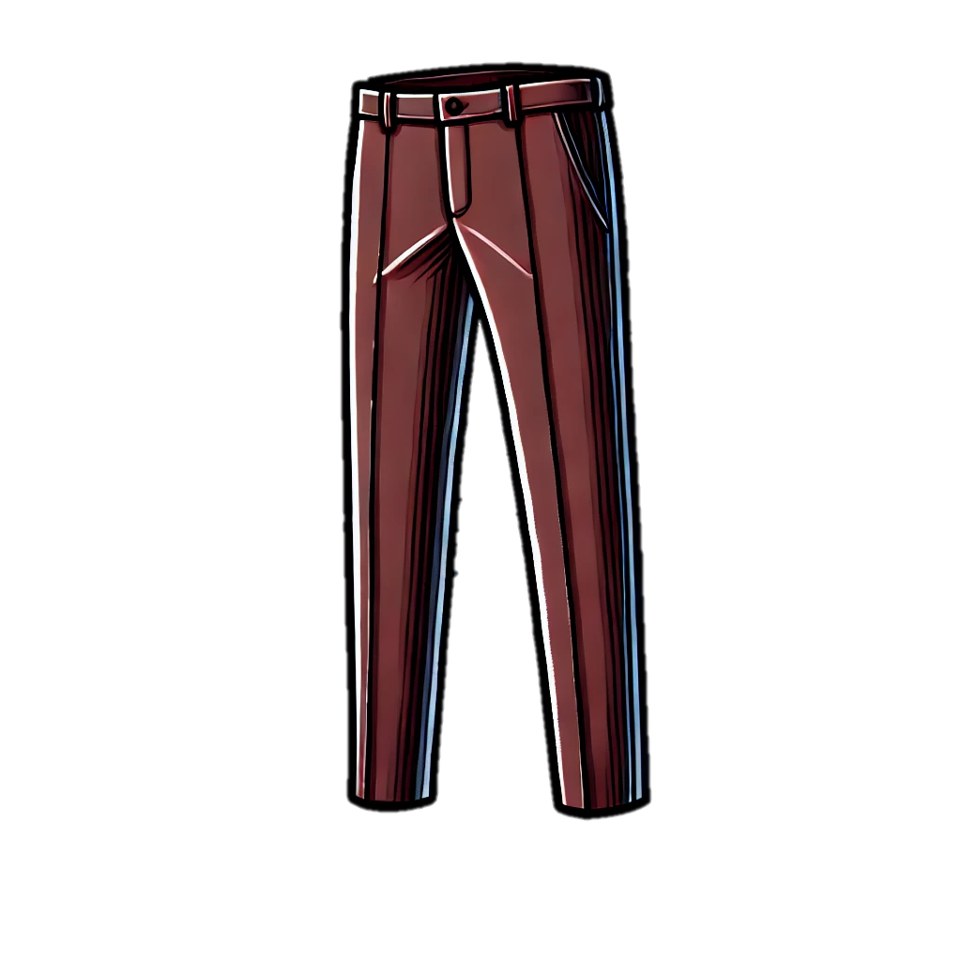
Tracer & Colorer
Ma garde-robe
Pantalon

Slide 8
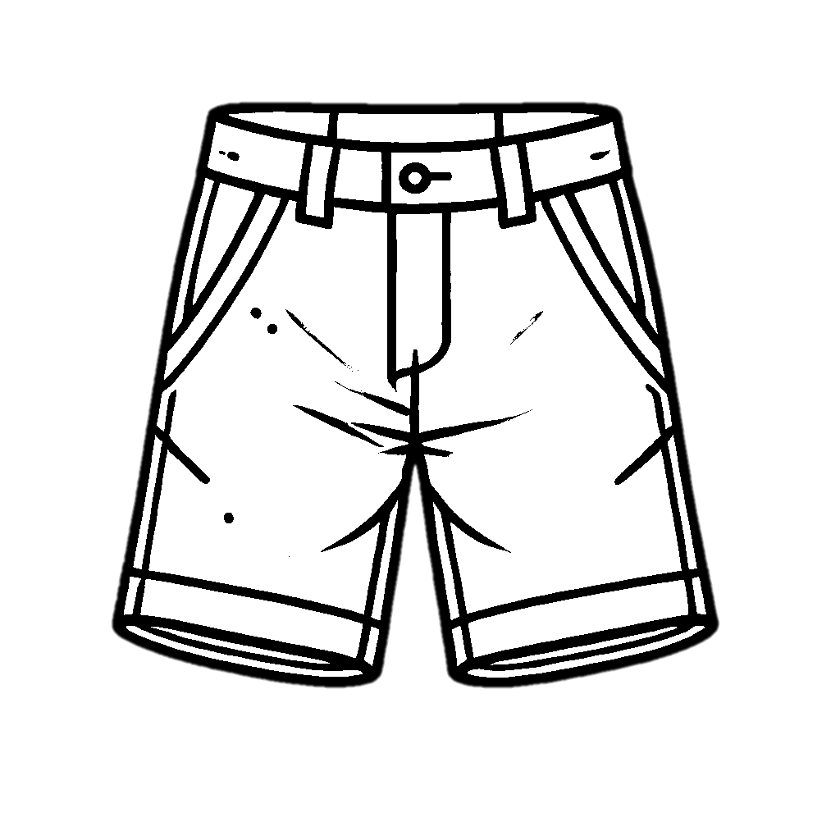

Tracer & Colorer
Ma garde-robe
Short

Slide 9

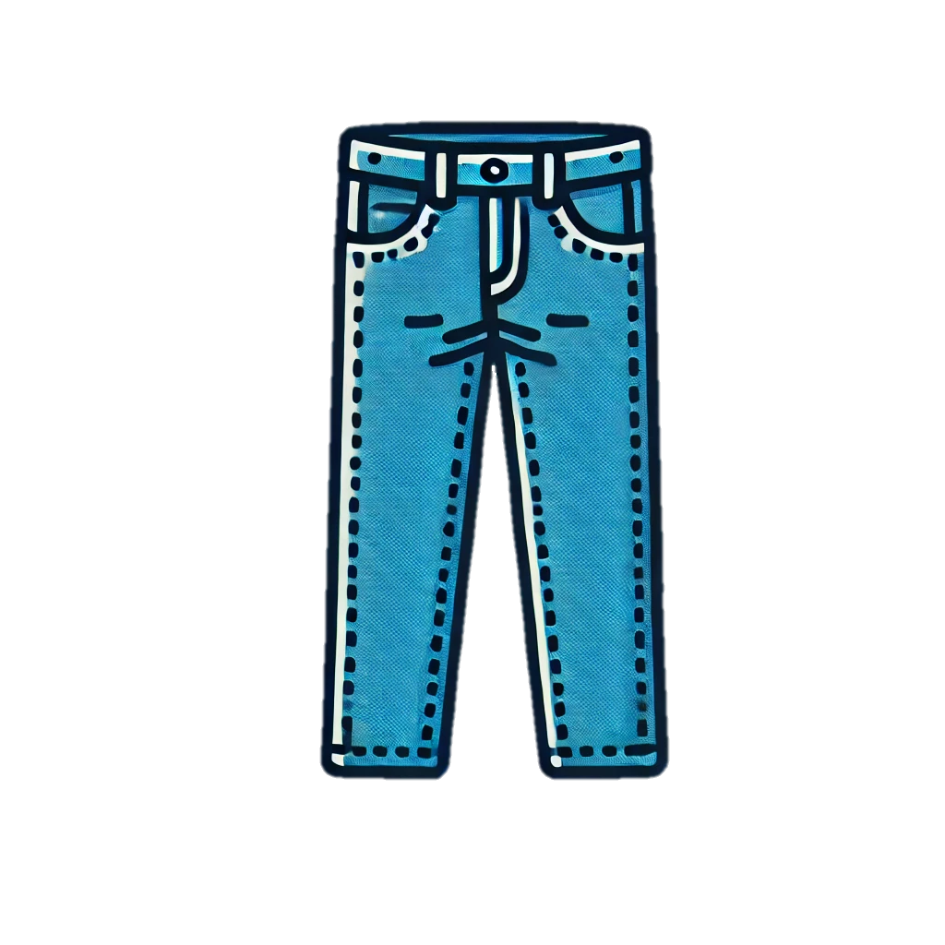
Tracer & Colorer
Ma garde-robe
Jeans

Slide 10
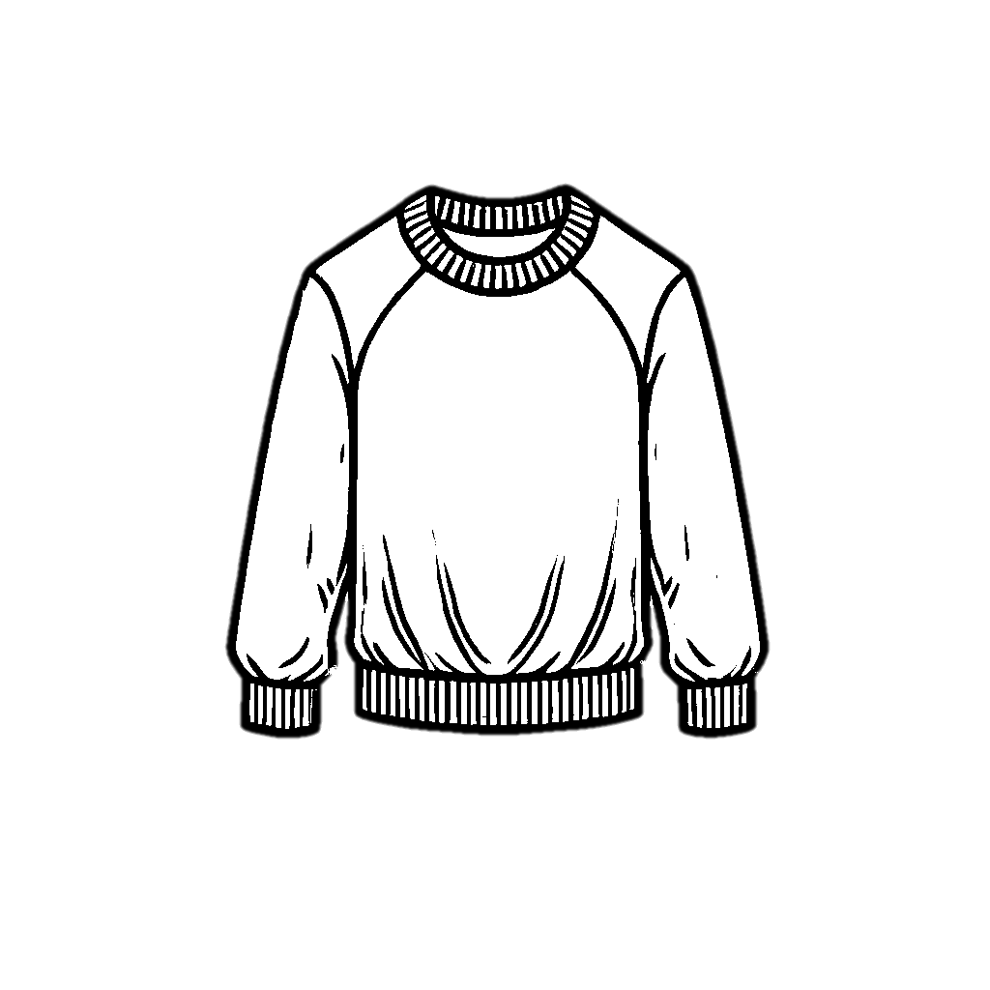
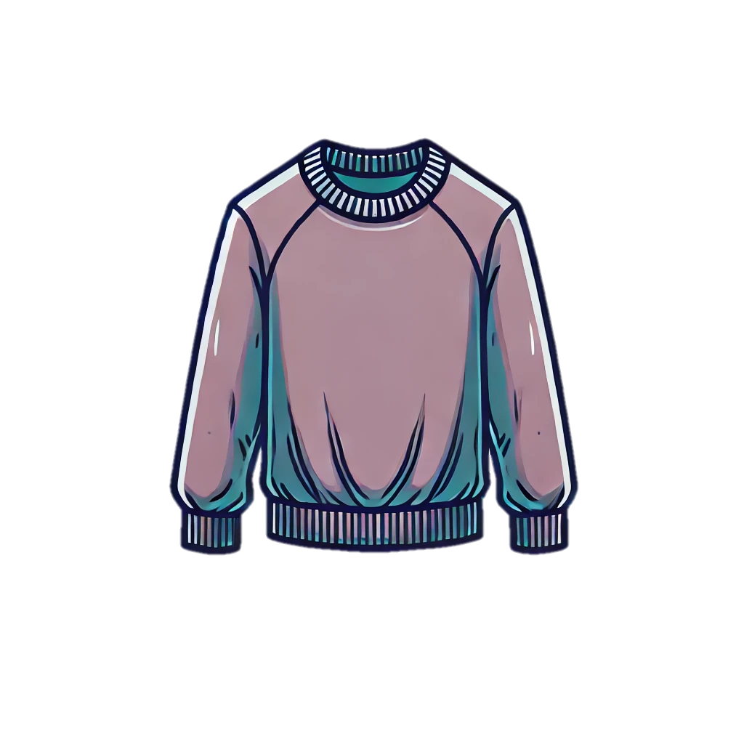
Tracer & Colorer
Ma garde-robe
Pull

Slide 11


Tracer & Colorer
Ma garde-robe
Cardigan

Slide 12
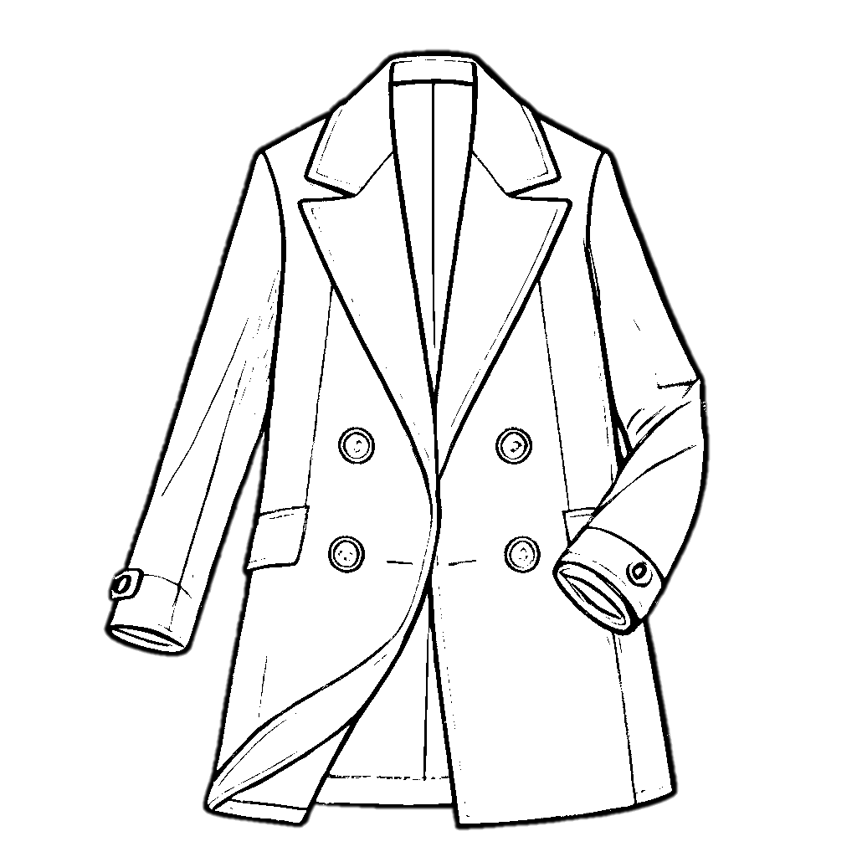
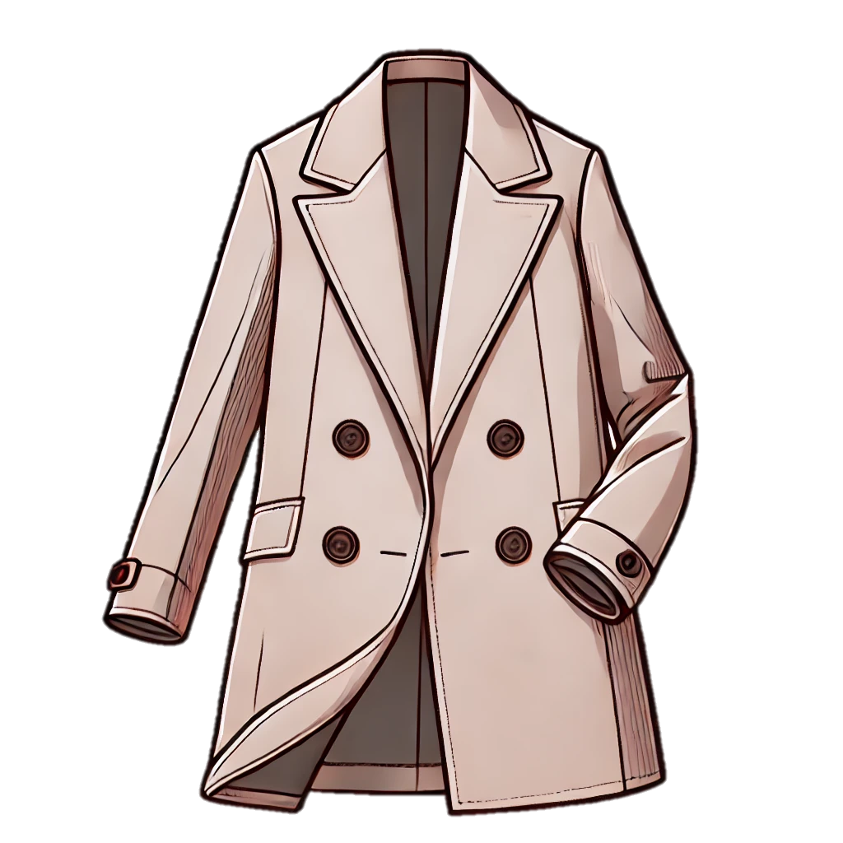
Tracer & Colorer
Ma garde-robe
Manteau

Slide 13
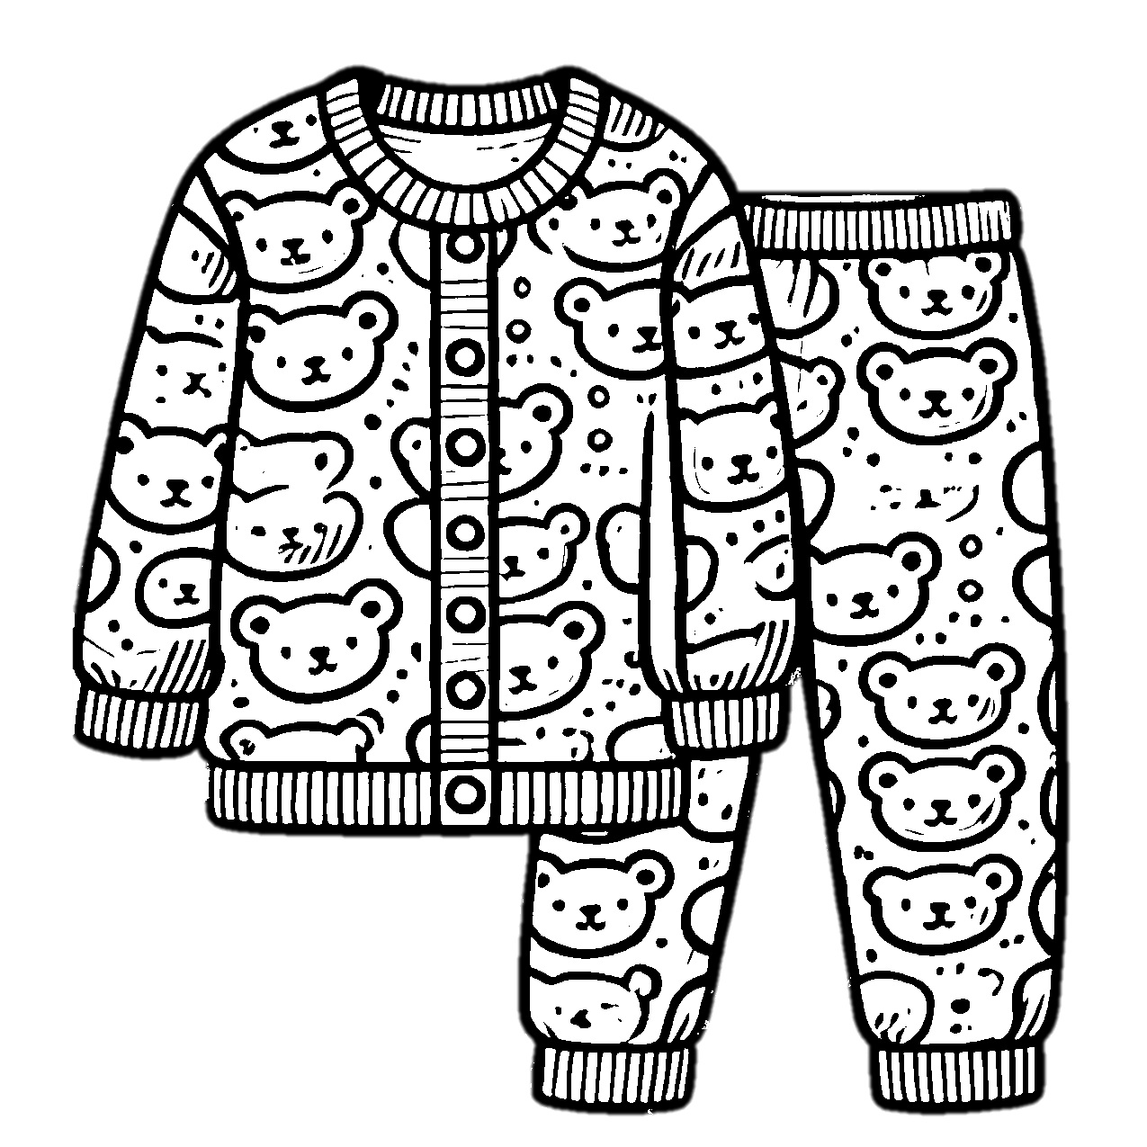
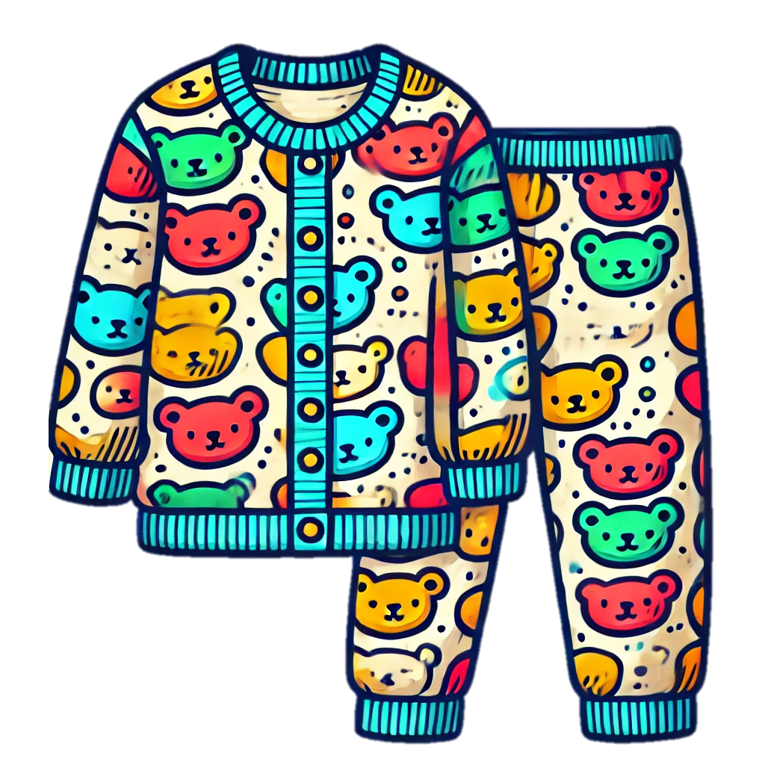
Tracer & Colorer
Ma garde-robe
Pyjama

Slide 14


Tracer & Colorer
Ma garde-robe
Chaussettes

Slide 15


Tracer & Colorer
Ma garde-robe
Veste

Slide 16


Tracer & Colorer
Ma garde-robe
Pants

